Slide 1


Slide 2
Architectural Design

Slide 3
Introduction
Design has been described as a multistep process in which representations of data and program structure, interface characteristics, and procedural detail are synthesized from information requirements.
Design is an activity concerned with making major decisions, often of a structural nature.

Slide 4
Design builds coherent, well planned representations of programs that concentrate on the interrelationships of parts at the higher level and the logical operations involved at the lower levels

Slide 5
Software Design Model
Functional
model
Information
model
Behavioral
model
Data design
Design
Architectural
design
Code
Other
requirements
Integrated
& validated
software
Procedural
design
Program
modules
Test

Slide 6
Steps
Architectural Design
Begins with
Data Design
Proceeds to
Architectural structure of the system

Slide 7
Steps (contd.)
Analysis of alternative
architectural styles or patterns
Selection of
Alternative
Elaboration of
Architecture

Slide 8
Software Architecture
What Is Architecture?
  The software architecture of a program or computing system is the structure or structures of the system, which comprise software components, the externally visible properties of those components, and the relationships among them.
  The architecture is not the operational software.

Slide 9
Architectural Styles
Each style describes a system category that encompasses: (1) a set of components (e.g., a database, computational modules) that perform a function required by a system, (2) a set of connectors that enable “communication, coordination and cooperation” among components, (3) constraints that define how components can be integrated to form the system, and (4) semantic models that enable a designer to understand the overall properties of a system by analyzing the known properties of its constituent parts.
Data-centered architectures
Data flow architectures
Call and return architectures
Object-oriented architectures
Layered architectures

Slide 10
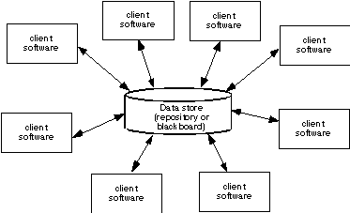
Data-Centered Architecture

Slide 11
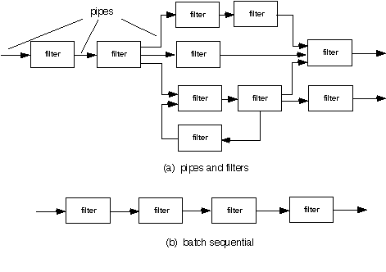
Data Flow Architecture

Slide 12
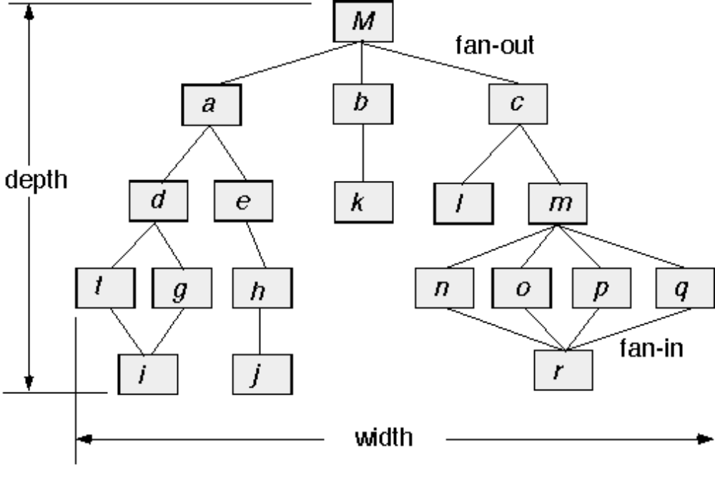
Call and Return Architecture

Slide 13
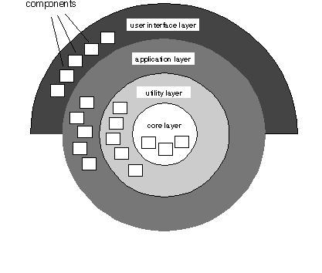
Layered Architecture

Slide 14
Mapping Requirements into a Software Architecture

Slide 15
An Architectural Design Method
customer requirements
"four bedrooms, lounge, drawing & dinning,
lots of glass ..."
architectural design

Slide 16
Mapping Requirements Into Software Architecture
Earlier had said certain models can be mapped directing into
an architectural design
  methods do not exist for all architectural styles
  Will look at 1 approach for the call & return architecture sometimes called structured design - origins in top-down design [WIR71], structured programming [DAH72],
    SD is a data-flow oriented design method
      Provides a method to go from a DFD to program structure

Slide 17
Deriving Program Architecture
Program
Architecture

Slide 18
Structured Design
objective: develop a modular program structure and represent control relationships between modules
approach:
  the DFD is mapped into a program architecture
  the PSPEC and STD are used to indicate the content of each module
notation: structure chart

Slide 19
Structured Design
It provides a convenient transition from a data flow diagram to software Architecture
  The type of information flow is established
  Flow boundaries are indicated
  The DFD is mapped into program structure
  Control hierarchy is defined
  Resultant structure is refined using design measures and heuristics
  The architectural description is refined and elaborated

Slide 20
Types of Information Flow
There are 2 different types of information flow that have different treatments
  Transform flow - Overall data flows in sequential manner and follows one, or only a few, “straight line” paths. (incoming, transform, output)
  Transaction Flow - Info flow has a single transaction node that triggers other data flow

Slide 21
Transform Flow
incoming flow
outgoing flows
A
B
transform
center
C

Slide 22
Transform Flow
  Incoming Flow: The paths that transform the external data into an internal form
  Transform Center: The incoming data are passed through a transform center and begin to move along paths that lead it out of the software
  Outgoing Flow: The paths that move the data out of the software
Transform flow

Slide 23
Transform Flow Characteristics
the system has a single, coherent objective
transformation center executes algorithms, data transformation, database manipulation, ...
input-driven processes filter, check and translate external data flows
output-driven processes format results for presentation to the environment (user)
multiple paths to obtain input

Slide 24
Transform Analysis: mapping heuristic
i1
tc1
o1
o2
i2
tc2
o3
sys
I-ctrl
P-ctrl
O-ctrl
i1
i2
tc1
tc2
o1
o3
o2

Slide 25
Transaction Flow
Transaction
Action paths
T
Transaction
center

Slide 26
Transaction Flow
  Information flow is often characterized by a single data item, called a transaction that triggers other data flow along one of many paths
  Action Paths :The transaction is evaluated and based on its value flow along one of many action paths
  Transaction center :The hub of info flow from which many action paths originate
Transaction
flow

Slide 27
Transaction Flow Characteristics
single line of reception processes
transaction: a single data item that includes all necessary information for execution
transaction center evaluates transaction & initializes correct action-path => distribution
action-paths implement (clearly) different types of functionality => execution
an action-path could be a complete
(sub-)system with transform flow characteristics

Slide 28
Transaction Analysis:
mapping heuristic
r1
sys
r2
trc
r2
trc
r1
s1
s2
i1
i2
i2
cot
o1
cot
i1
o1

Slide 29
Transaction Analysis
may include
Transform Analysis
as an element.

Slide 30
Transform Analysis as an element of Transaction Analysis
r1
sys
r2
r2
trc
r1
trc
s1
s2
i1
i2
i2
cot
o1
cot
i1
o1

Slide 31
Transform Mapping (cont)
Design steps
  Step 1. Review the fundamental system model.
  Step 2. Review and refine data flow diagrams for the software.
  Step 3. Determine whether DFD has transform or transaction flow characteristics.
    in general---transform flow
    special case---transaction flow

Slide 32
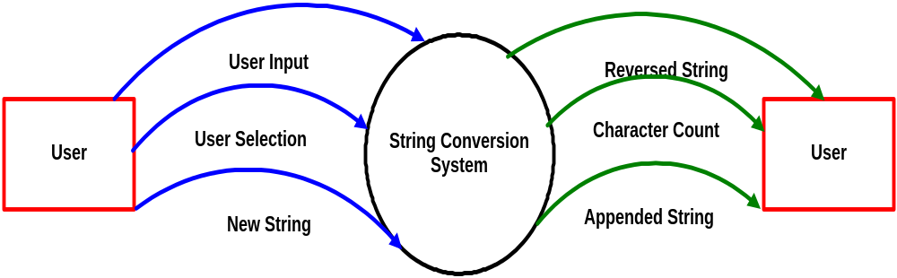
Context Level DFD

Slide 33
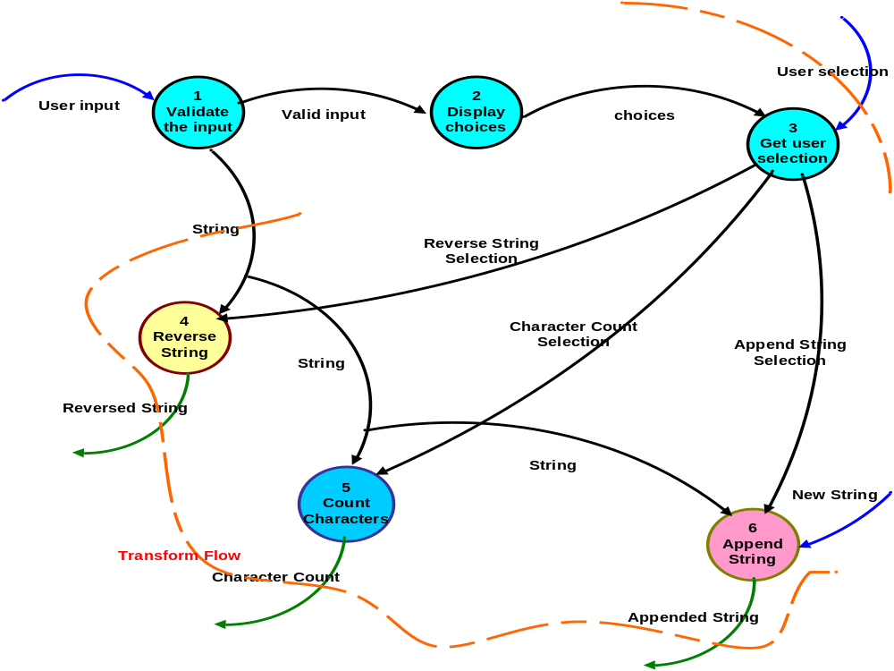
Level 1 DFD

Slide 34
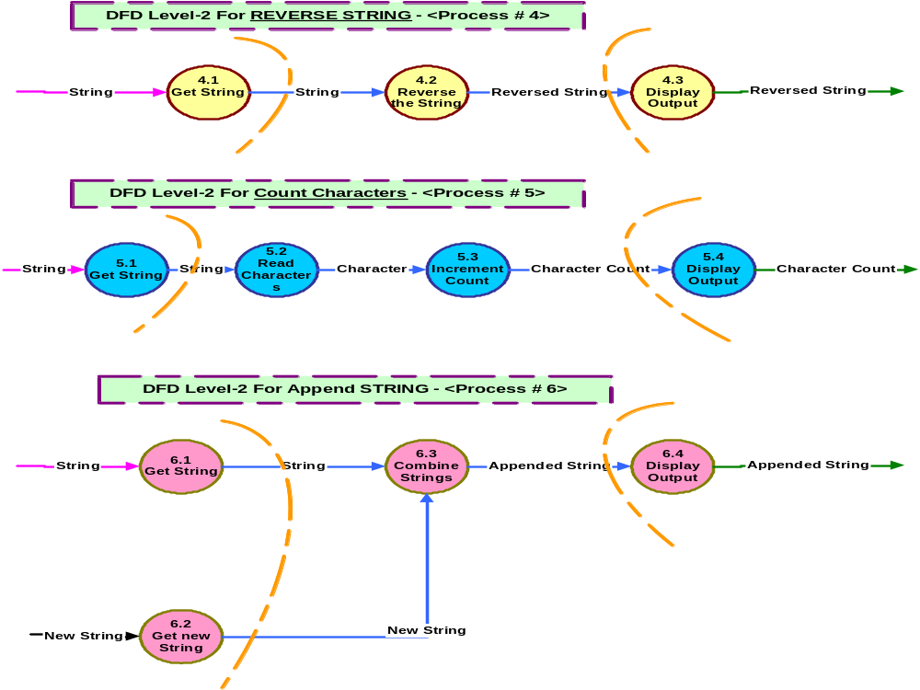

Slide 35
Transform Mapping (cont)
Step 4. Isolate the transform center by specifying incoming and outgoing flow boundaries
  different designers may select slightly differently
  transform center can contain more than one bubble.
Step 5. Perform “first-level factoring”
  program structure represent a top-down distribution control.
  factoring results in a program structure(top-level, middle-level, low-level)
  number of modules limited to minimum.

Slide 36
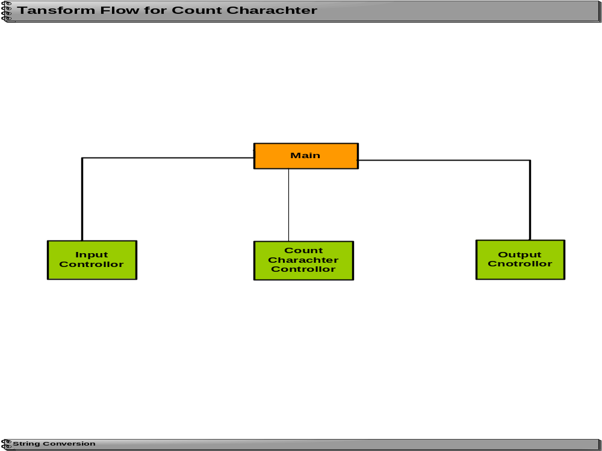
First Level Factoring

Slide 37
Transform Mapping (cont)
  Step 6. Perform “second-level factoring”
    mapping individual transforms(bubbles) to appropriate modules.
    factoring accomplished by moving outwards from transform center boundary.
  Step 7. Refine the first iteration program structure using design heuristics for improved software quality.

Slide 38






Transform Flow for Count Character
Second Level Factoring
Main
Input
Count
Output
Controller
Character
Controller
Controller
Get String
Read
Increment
Display
Character
Count
Output
String Conversion

Slide 39
Transaction Mapping
A single data item triggers one or more information flows

Slide 40
Transaction Mapping Design
Step 1.Review the fundamental system model.
Step 2.Review and refine DFD for the software
Step 3.Determine whether the DFD has transform or transaction flow characteristics
Step 4. Identify the transaction center and flow characteristics along each of the action paths
    isolate incoming path and all action paths
    each action path evaluated for its flow characteristic.

Slide 41
Transaction Mapping (cont)
Step 5. Map the DFD in a program structure amenable to transaction processing
  incoming branch
    bubbles along this path map to modules
  dispatch branch
    dispatcher module controls all subordinate action modules
    each action path mapped to corresponding structure

Slide 42
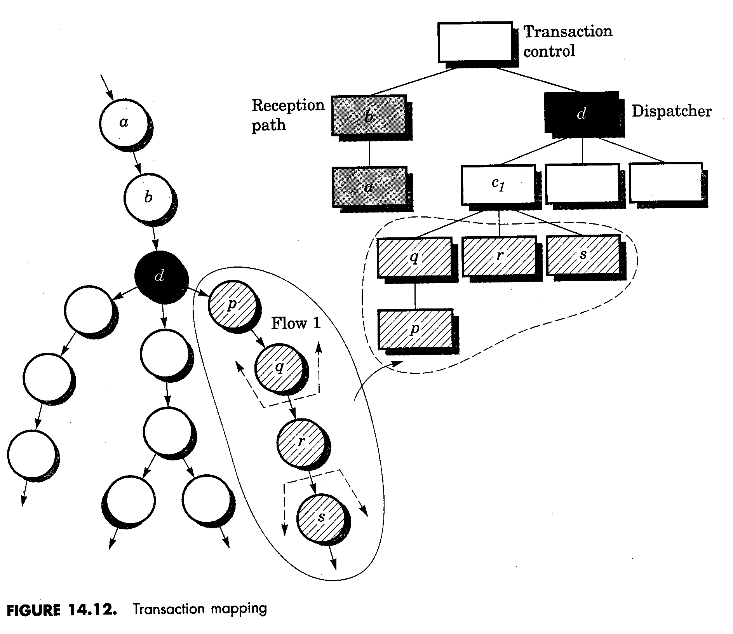
Transaction Mapping

Slide 43
First Level Factoring
String Conversion Executive
Display Choices
Get User Selection
Validate the Input
Reverse String
Controller
Append String
Controller
Count String
Controller

Slide 44
String Conversion Executive
Append String
Controller
Display Choices
Get User Selection
Validate the Input
Input String
Controller
Append Str
Count String
Controller
Reverse String
Controller
Processing Controller
Get new Str
Read Char.
Increment Count
Reverse String
Display Output
Get String

Slide 45
Transaction Mapping (cont)
Step 6. Factor and refine the transaction structure and the structure of each action path
Step 7. Refine the first iteration program structure using design heuristics for improved software quality

Slide 46
Design Post processing
A processing narrative must be developed for each module
An interface description is provided for each module
Local and global data structures are defined
All design restrictions/limitations are noted
A design review is conducted
“Optimization” is considered (if required and justified)

Slide 47
Summary
Data-flow oriented design:
Natural flow from analysis
  Find type of information flow
  Find flow boundaries
  Map DFD to program flow
  Factor control
  Refine structure

Slide 48
References:
Software Engineering - A practitioner’ s Approach by Roger S. Pressman (6th Ed)
  10.1, 10.3,10.6
Software Engineering - A practitioner’ s Approach by Roger S. Pressman(5th Ed)
  Chapter 14
    14.1-(14.1.1, 14.1.2), 14.3-(14.3.1), 14.5-(14.5.1, 14.5.2), 14.6-(14.6.1, 14.6.2), 14.7-(14.7.1, 14.7.2)

